Slide 1

Notes:
Mention company big picture
A Mobile First company building Beautiful, Intuitive platforms for application and business development

Slide 2
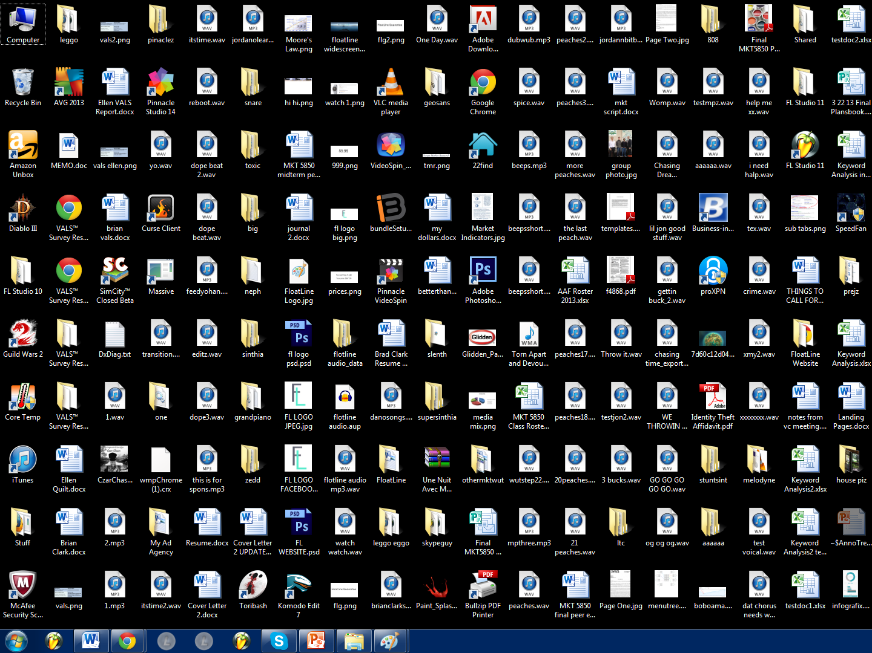

Problem
Building mobile applications can easily be a tedious and unorganized process
Gathering feedback directly from testers or designers is generally not straightforward
Collaborating on these changes is also a crucial part that can be improved on

Slide 3
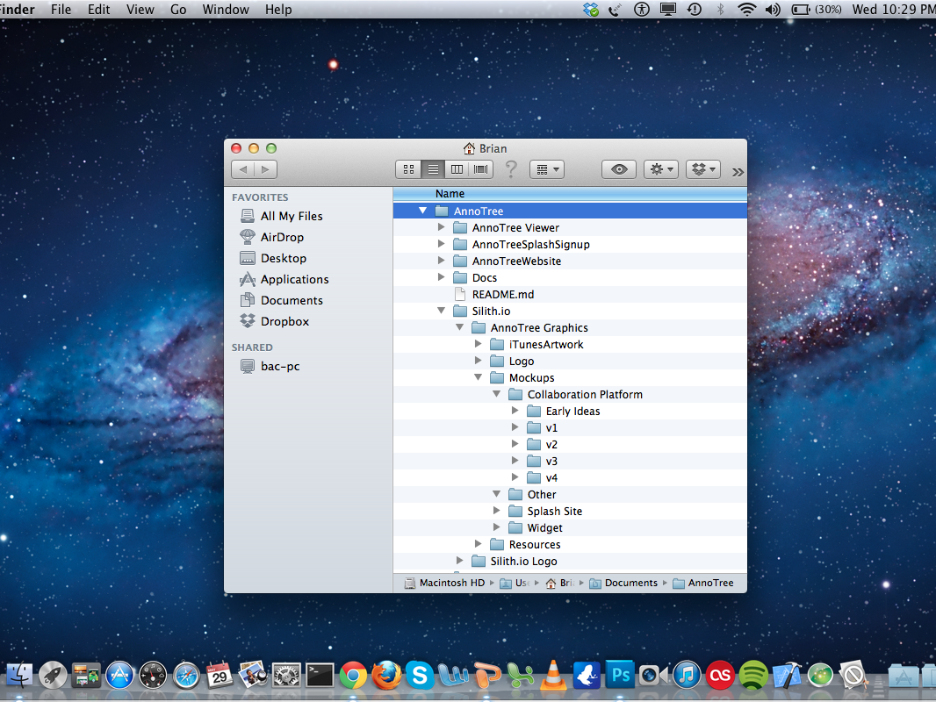

Slide 4



AnnoTree
AnnoTree is a new way to organize and collaborate on design and testing for mobile applications
Notes:
Sends to cloud
Organized in CCP

Slide 5
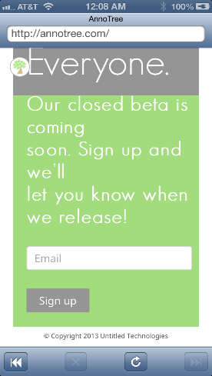
Notes:
Widget on app implemented with one line of code as an SDK

Slide 6
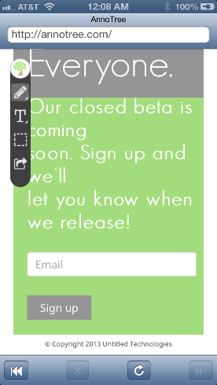

Slide 7
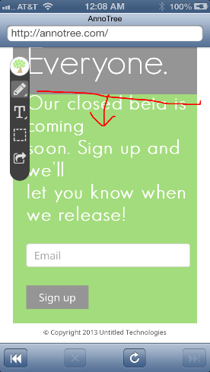

Slide 8
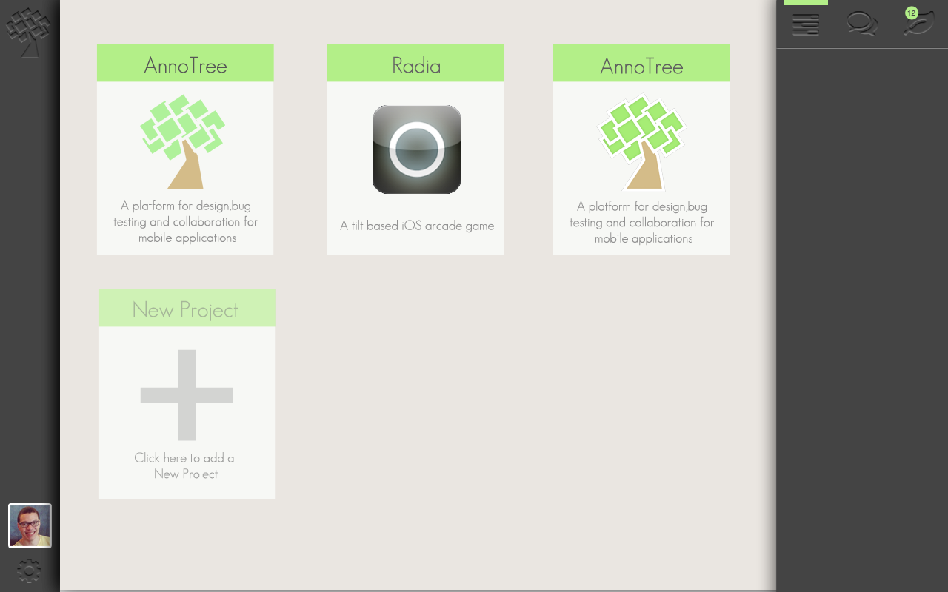
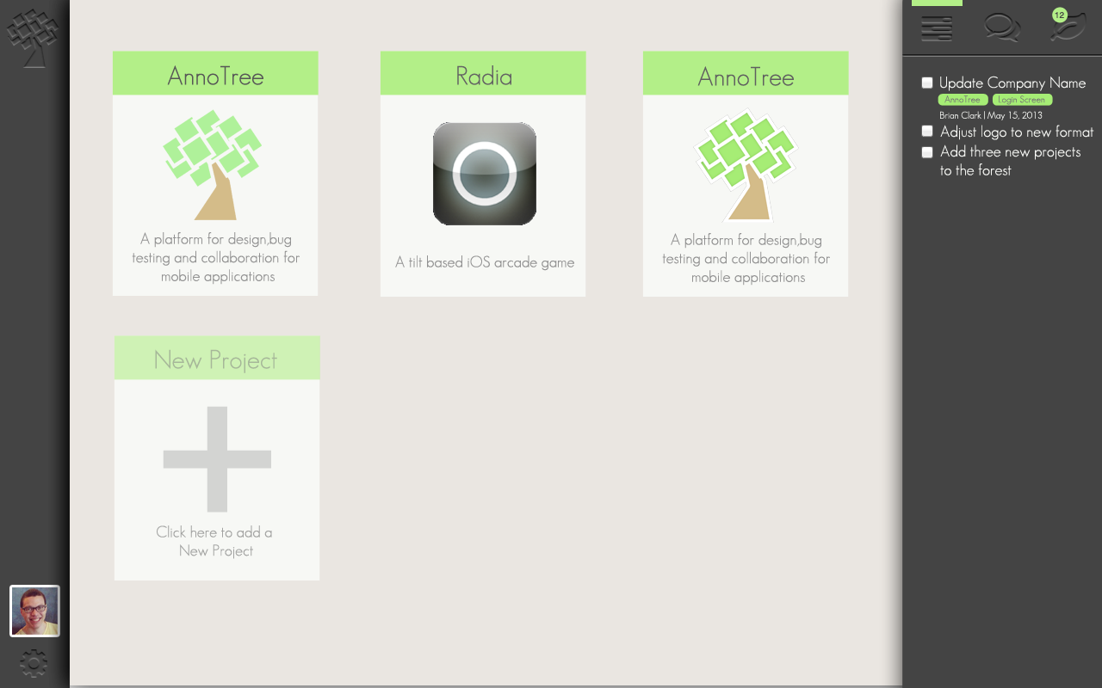
Notes:
Forest CCP with Notifications

Slide 9
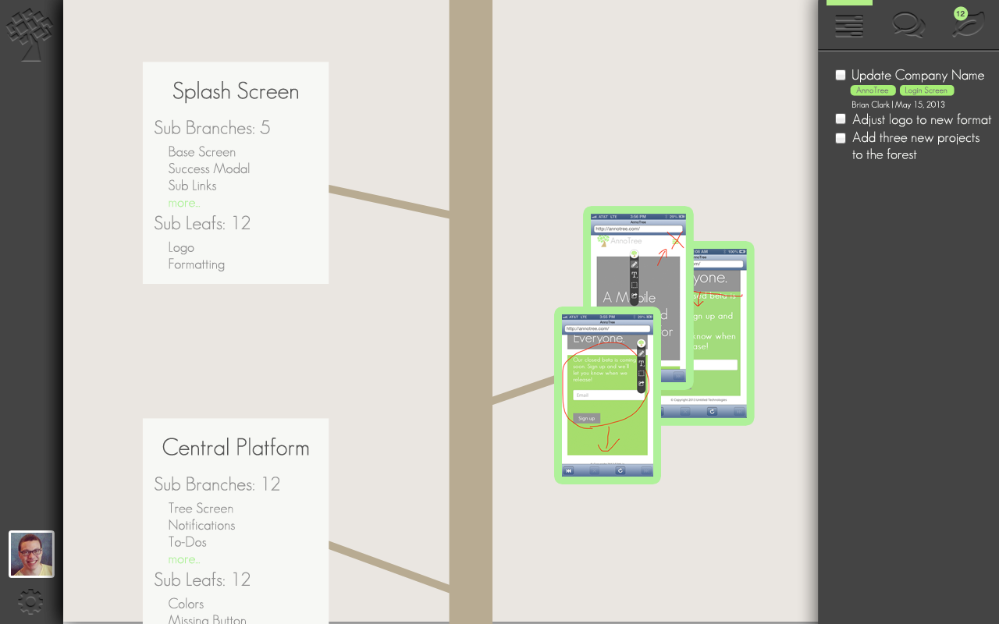
Notes:
Tree and Branches CCP with Specific To-Do’s

Slide 10
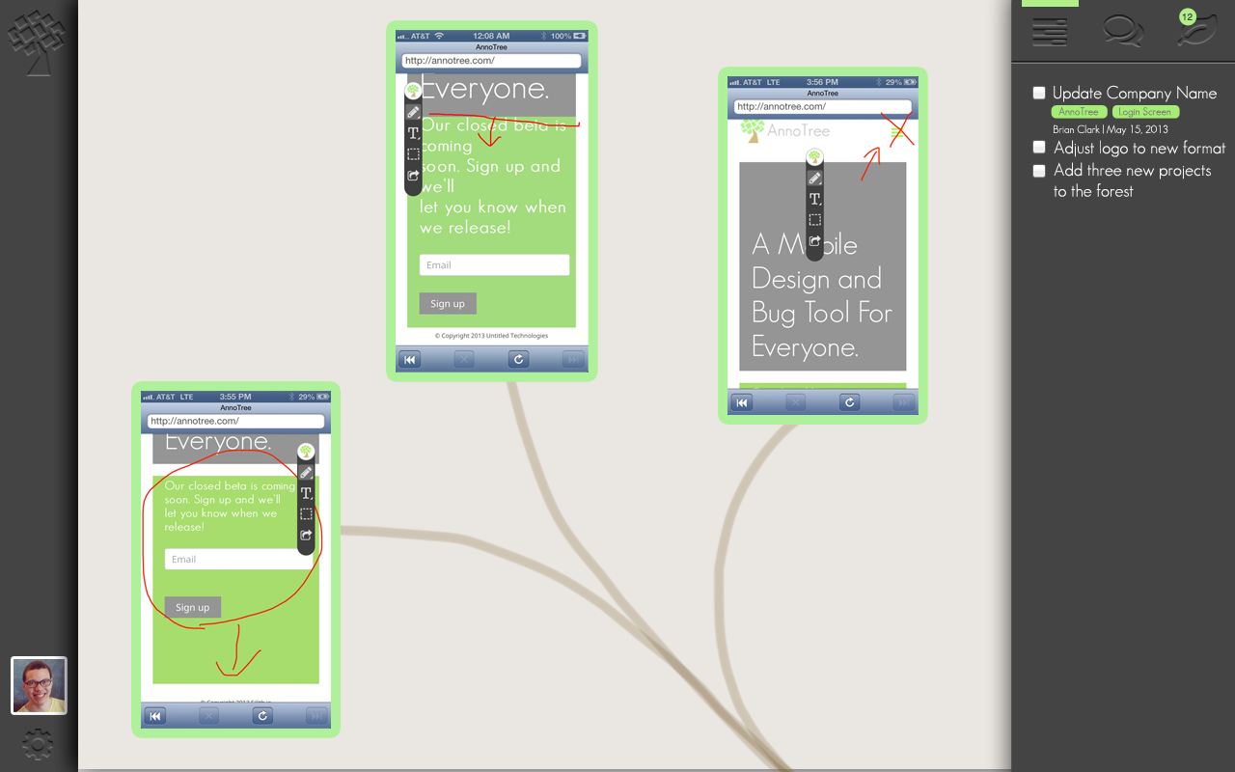
Notes:
Tree and Branches CCP with Specific To-Do’s

Slide 11
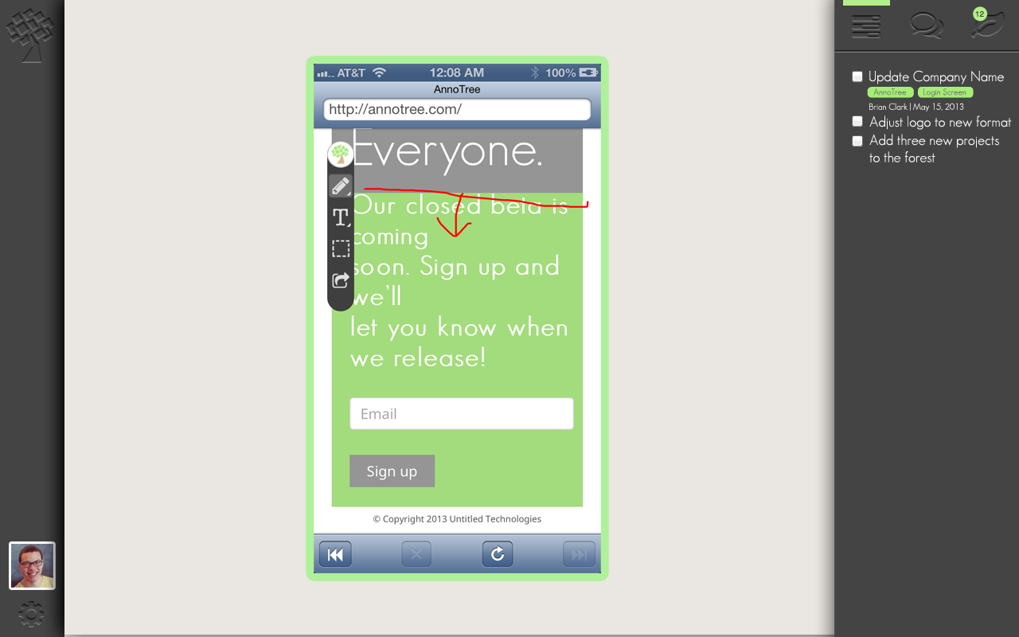
Notes:
Tree and Branches CCP with Specific To-Do’s

Slide 12

Market Size
US$9 billion in 2012.
Notes:
http://www.drdobbs.com/cloud/application-development-now-worth-more-t/240006233
http://readwrite.com/2011/07/05/app-development-services-market-to-reach-100-billion-by-2015
More insightful perhaps are predictions that mobile application development projects targeting smartphones and tablets will outnumber native PC projects by a ratio of 4:1 by 2015.
Need Top Down (reported overall) and bottom up (calculated by people and $)
With this increase in market size, it has become harder and harder to differentiate your application from the competition. In order to have a successful application you must create an application with the fit and finish of large firms with large budgets. (testing mobile app revenue)
825k Apple App Store
850k Google Play Store
Millions of mobile websites/apps
Our Bottom Up Analysis indicates a potential market size of over $232M

Slide 13

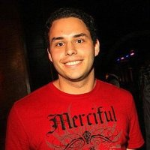
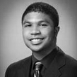
Engineering
Matt Price
Chief Technical Officer
Lord of the Servers
Michael Max
Lead Engineer
Hadooper Trooper
Dan Carter
Chief Information Officer
JavaScript Ninja

Slide 14


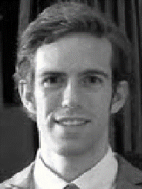
Business Development
Shaun Nikore
Chief Financial Officer
Brad Clark
Chief Marketing Officer
Preston Parry
Business Development

Slide 15
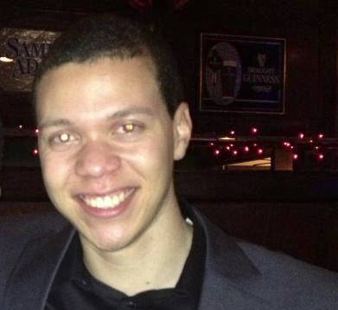
Brian Clark
Chief Executive Officer

Slide 16
What Next?
Milestones
MVP – Aug 2013
Closed Alpha – Sep 2013
Open Beta – Jan 2014
Seeking
Strategic Advisors
EIR Role
brian@silith.io

